Slide 1
ANALYZing AMAZON SALES DATA
Iqra Kaularikar​

Slide 2
AGENDA
Introduction​
Primary goals
​Areas of profit
Dashboard
​Summary​

Slide 3
Introduction
Analyzing Amazon sales data unveils valuable insights into consumer
behavior, market trends, and product performance. From unraveling patterns in purchasing behavior to understanding the impact of marketing strategies, diving into this data offers a panoramic view of the e-commerce landscape. This exploration enables businesses to make informed decisions, optimize their offerings, and stay ahead in the dynamic realm of online retail.

Slide 4
PRIMARY GOALS
The main objective of analyzing Amazon sales data is to obtain valuable insights that can inform decision-making. Through analyzing sales figures, trends, and consumer behavior patterns, businesses strive to comprehend customer preferences, optimize inventory, refine marketing strategies, and identify opportunities for growth. Ultimately, this analysis enables companies to enhance their product offerings, improve operational efficiency, and maximize their competitive advantage in the ever-changing e-commerce market.

Slide 5
AREAS OF PROFIT

Slide 6

AREAS OF PROFIT

Slide 7
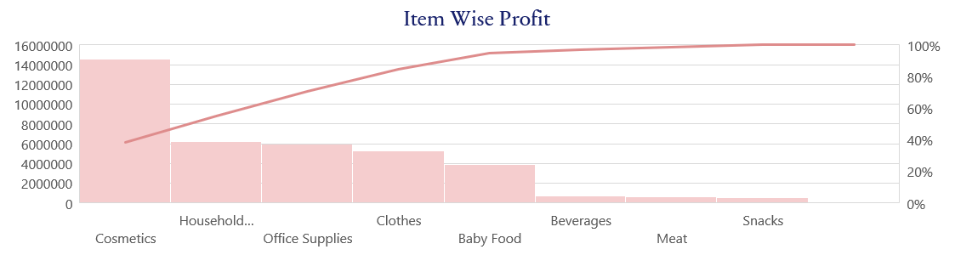
Areas of profit

Slide 8
Data analysts turn raw numbers into meaningful stories, unlocking the insights that shape smarter decisions and brighter futures.

Slide 9
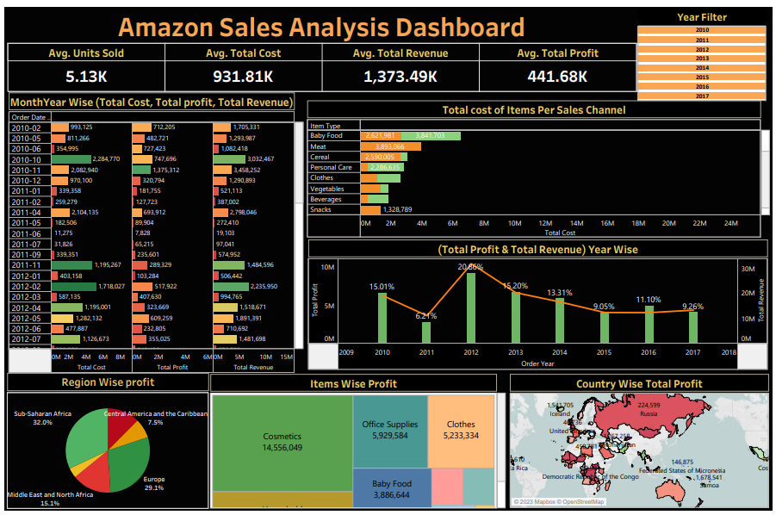
Dashboard

Slide 10
SUMMARY
Analyzing sales data on Amazon involves examining customer behaviors, market trends, and product performance. It is the process of uncovering what sells, why it sells, and when it sells. By thoroughly analyzing this data, businesses can gain valuable insights to optimize their inventory, refine marketing strategies, and make informed decisions for growth in the competitive e-commerce industry.

Slide 11
THANK YOU
Iqra Kaularikar
iqrakaularikar@gmail.com

